Slide 1
Team 68 Proposal​
- Nihar Moramganti​
- Yuchen Hu​
- Michael Cardenas​
- Linh Dang​
Analyzing the Impact of Macroeconomic Factors on Real Estate: A Study of CPI, Interest Rates, and Home Inventory

Slide 2
Objective/Problem
Purpose
We want to find which variables have the most influence on housing prices so we can better predict housing prices
We want to explore how these drivers influenced housing prices during COVID-19 and also how these factors played pre-pandemic as well
Want to build a model that would be the best fit for determining the most influential variables that will predict future housing prices
Business Justification
Predict housing prices so buyers know when to buy homes at the right time
Open up investment opportunities for consumers that want to buy property
President or Congress can pass laws that affect home inventory

Slide 3
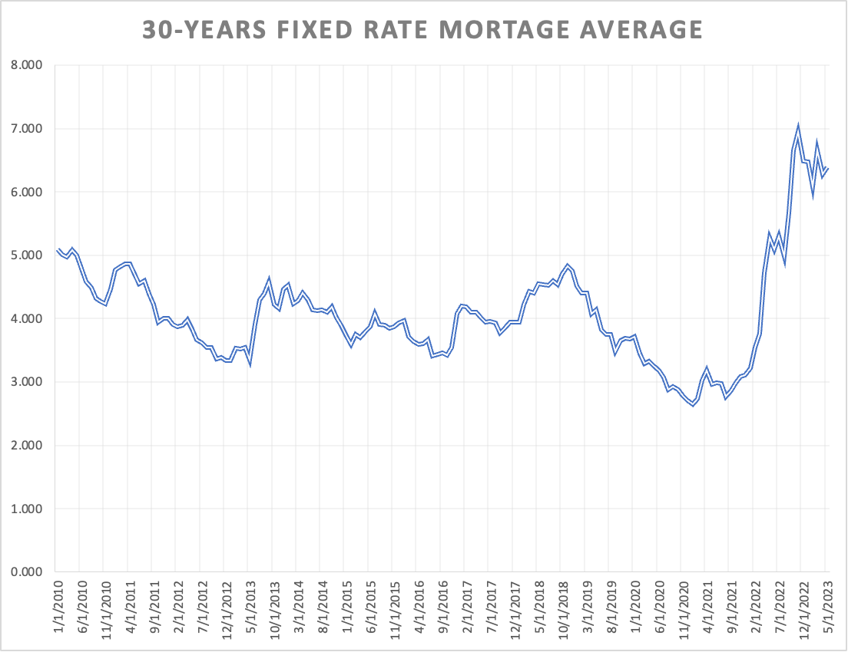
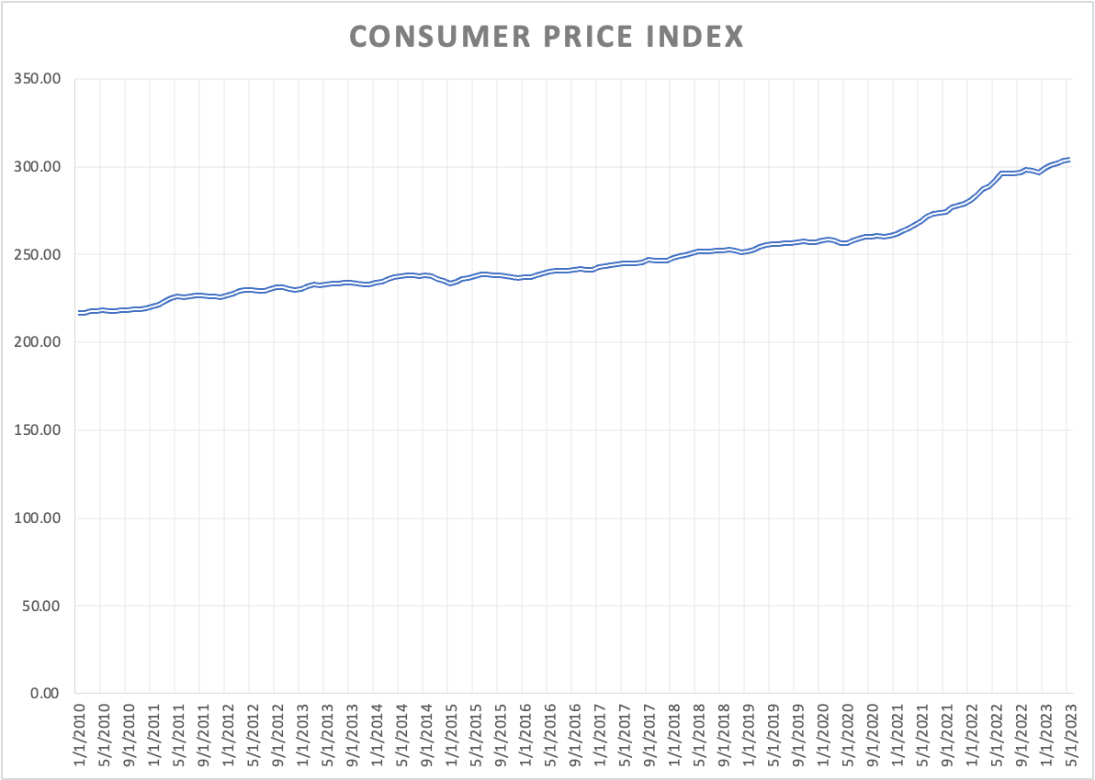
Project Datasets
Independent Datasets
30-Year Fixed Rate Mortgage Average in the United States (Federal Reserve Bank of St. Louis)
Consumer Price Index (CPI) for All urban Consumers (Bureau of Labor Statistics Data)
Active Listing Housing Inventory in the United States (Federal Reserve Bank of St. Louis)
Annual Estimates of the Resident Population for Counties (Census)
Dependent datasets
Zillow Home Value Index for All Home (SFR, Condo/Co-op) (Zillow research data)
Hypothesis of datasets

Slide 4
Approach/Methodology
Cleaning the data
Will require reshaping data from wide to long format
Formatting data types: e.g. datetime
Combining various data sets
Creating the model
Split data into training, validation, and testing sets
Analyze various models such as linear regression, decision trees, and random forest regression
Evaluate the model and optimize the model

Slide 5
Project Planning
& Timeline
How long do you think it will take?
5 weeks
What are some important milestones/goals to keep your projection track?
Stay ahead or on-time with course project deliverables (Gantt on next slide)
Additional team deliverables such as data cleansing, report first draft
How will progress towards these goals and outcomes be measured?
Project is sliced into weeks
Each week check in to determine project on-target status
Notes:
- successfully complete this project
- mapped out milestones, high level tasks, week to week
- approach each week
- specific responsibilities
- review last week
- project status check

Slide 6
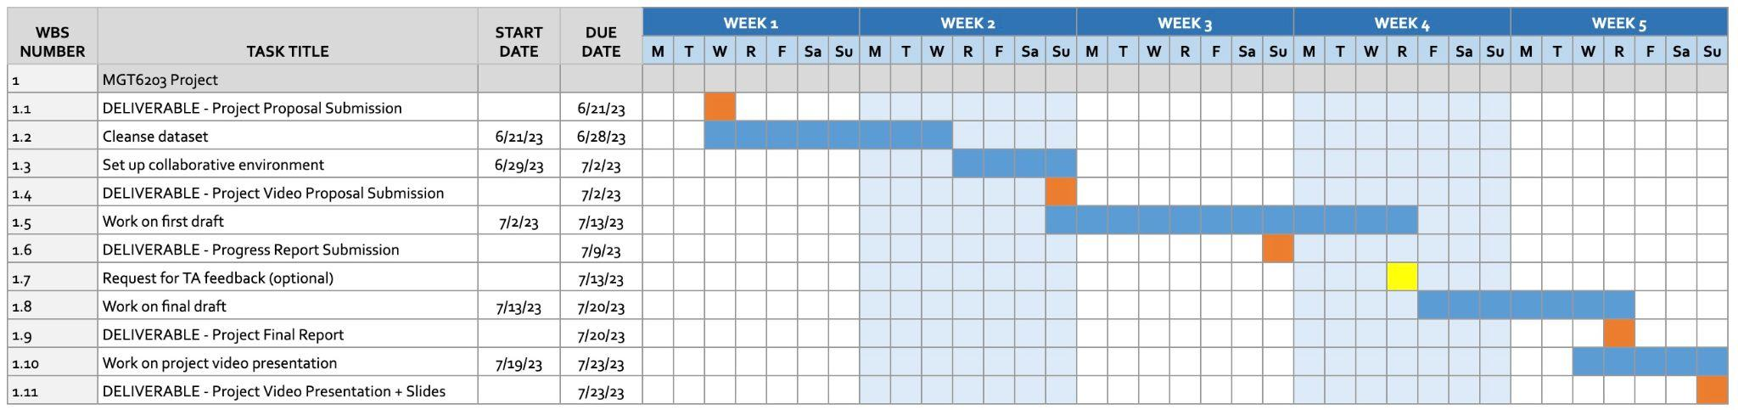
Notes:
- gantt chart

Slide 7

Citations
Serrano, Camilo, and Martin Hoesli. “Forecasting Ereit Returns.” Taylor & Francis Online, 18 June 2020, www.tandfonline.com/doi/abs/10.1080/10835547.2007.12089784.
Bernstein, Jared, et al. “Housing Prices and Inflation.” The White House, Sept. 2021, www.whitehouse.gov/cea/written-materials/2021/09/09/housing-prices-and-inflation.
Ghysels, Eric, et al. “Forecasting Real Estate Prices.” Handbook of Economic Forecasting, Elsevier BV, 2013, pp. 509–80. https://doi.org/10.1016/b978-0-444-53683-9.00009-8.

